Slide 1
Analysis Involving Collation of Data Science Algorithms
ANKUR YADAV
ADITYA TARI
NAVJEET PATTALI

Slide 2

Introduction
Machine learning today is not like machine learning of the past
Machine Learning is an Iterative process
Data is the most precious resource for an Organisation
Industrial fields require ML algorithms to extract information from large collection of data
“More data beats clever algorithm, better data beats more data”
Notes:
tari-1to8
ankur-9to14
navjeet-15to25

Slide 3
What is necessary for good machine learning algorithm?
Data preparation capabilities.
Algorithms – basic and advanced.
Automation and iterative processes.
Scalability.
Ensemble modeling.
Notes:
Notes to presenter:
Description of what you learned in your own words on one side.
Include information about the topic
Details about the topic will also be helpful here.
Tell the story of your learning experience. Just like a story there should always be a beginning, middle and an end.
On the other side, you can add a graphic that provides evidence of what you learned.
Feel free to use more than one slide to reflect upon your process. It also helps to add some video of your process.

Slide 4

Problem Statement
When you work on a machine learning project ,common task is to search for the most appropriate algorithm(s)to retrieve important information from data. With an increasing number of available data mining techniques, it may be impractical to experiment with many techniques on a specificdataset of interest to find the best algorithm(s).
Notes:
Notes to presenter:
What is your purpose for sharing this reflection?
Is it at the end of a unit or project?
Are you sharing this reflection, at the attainment of a learning goal you set for yourself?
Is it at the end of a course?
State your purpose for the reflection or even the purpose of the learning experience or learning goal. Be clear and be specific in stating your purpose.

Slide 5
Proposed Idea
When you look at machine learning algorithms, there is no one solution or one approach that fits all.
There are several factors that can affect your decision to choose a machine learning algorithm
Some problems are very specific and require a unique approach.E.g Recommender System
While some other problems are very open and need a trial & error approach.
Supervised learning,classification and regression etc. are very open. They could be used in anomaly detection, or they could be used to build more general sorts of predictive models.

Slide 6
Project Objective
Create a training set from original datasets and evaluate performance of algorithm onthese transformed datasets.
Select a good model with best performance on test dataset.
Generate a ranked list of machine learning algorithms using performance measures.We then present statistical summary of the comparisons carried out.

Slide 7
Role of Domain Experts
What’s happening in the Industry
Advantage of our Proposal

Slide 8
Types of ML Problems There are several subclasses of ML problem based on what the prediction task looks like.
Type of ML Problem | Description | Example
Classification | Pick one of N labels | Cat, dog, horse, or bear
Regression | Predict numerical values | Click-through rate
Clustering | Group similar examples | Most relevant documents (unsupervised)
Association rule learning | Infer likely association patterns in data | If you buy hamburger buns, you're likely to buy hamburgers (unsupervised)
Structured output | Create complex output | Natural language parse trees, image recognition bounding boxes
Ranking | Identify position on a scale or status | Search result ranking

Slide 9

What are our steps?
Select Problem Domain & Dataset
4
Train Model for dataset
3
2
Evaluate Models
1
Suggest Suitable Model
Notes:
Notes to presenter:
What steps will you be taking as a result of this learning experience?
Did you learn from any failed experiences? How will you do things differently?
What advice will you give to others so they can learn from your experiences?
How can you share what you learned with a real-world audience?
Some examples of next steps might be:
After delivering my first persuasive presentation, I am thinking about joining the debate team.
After making my first film, I’m considering entering it in our school film festival or local film festival.
After connecting with this career expert, I’d like to do some research on that career field because it sounds interesting to me.
This SmartArt allows you add images and text to help outline your process. If a picture is worth a thousand words, then pictures and words should help you communicate this reflection on learning perfectly! You can always click on Insert>SmartArt to change this graphic or select the graphic and click on the Design contextual menu to change the colors.
Feel free to use more than one slide to share your next steps. It also helps to add some video content to explain your message.

Slide 10
Approach
Importance of identifying the Correct Problem Domain
Some problems are very specific and require a unique approach
While some other problems are very open and need a trial & error approach.

Slide 11
Categorize The Problem
1) Categorize by input:
•If you have labelled data, it’s a supervised learning problem.
•If you have unlabelled data and want to find structure, it’s an unsupervised learning problem.
•If you want to optimize an objective function by interacting with an environment, it’s a reinforcement learning problem
2) Categorize by output.
•If the output of your model is a number, it’s a regression problem.
•If the output of your model is a class, it’s a classification problem.
•If the output of your model is a set of input groups, it’s a clustering problem.
•Do you want to detect an anomaly ? That’s anomaly detection

Slide 12
Prepare Data Set
Clean Data:
Dealing with missing data
Choose what to do with outliers
Aggregate the data that needs to be aggregated

Slide 13
Prepare Data Set
Augment Data
Feature engineering is the process of going from raw data to data that is ready for modelling. It can serve multiple purposes:
Make the models easier to interpret (e.g. binning)
Capture more complex relationships (e.g. NNs)
Reduce data redundancy and dimensionality (e.g. PCA)
Rescale variables (e.g. standardizing or normalizing)

Slide 14
Algorithms
Clustering:
User Based Collaborative Filtering
Item Based Collaborative Filtering
Alternating Least Sqaure
Regression:
Linear Regression
Polynomial Regression
Logistic Regression

Slide 15
EVALUATION METRICS
Each machine learning model is trying to solve a problem with a different objective using a different dataset and hence, it is important to understand the context before choosing a metric.
Regression Metrics:
Mean Squared Error (MSE)
Root Mean Squared Error (RMSE)
Mean Absolute Error (MAE)
R Squared (R²)

Slide 16
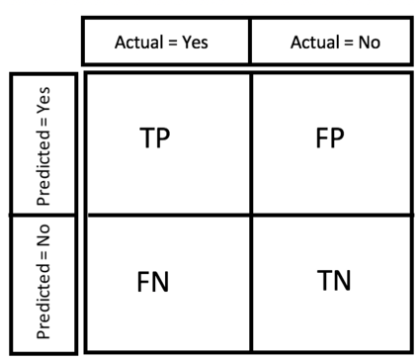
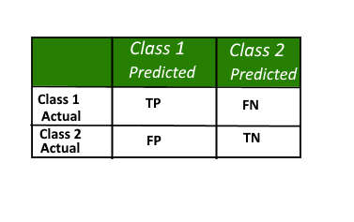
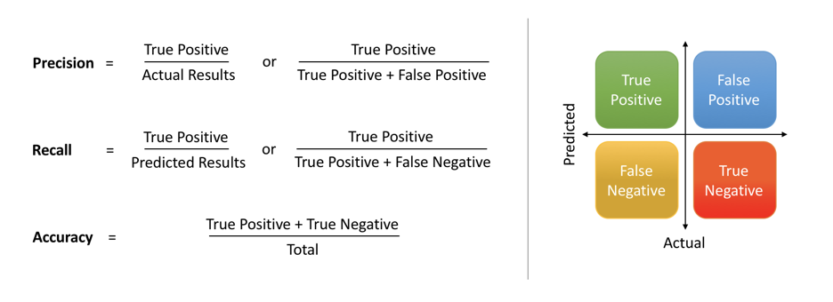
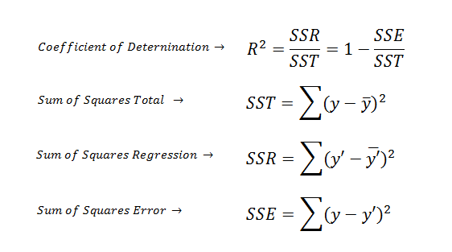
Confusion Matrix
Precision &Recall
R² Metric
Notes:
Notes to presenter:
What was important about this learning experience?
How is it relevant to your course, yourself, or your society or community?
Why is this significant?
This SmartArt allows you add images and text to help outline your process. If a picture is worth a thousand words, then pictures and words should help you communicate this reflection on learning perfectly! You can always click on Insert>SmartArt to change this graphic or select the graphic and click on the Design contextual menu to change the colors.

Slide 17
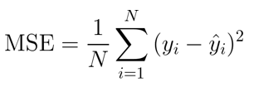
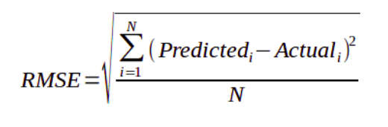
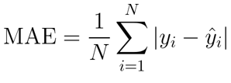
MSE
RMSE
MAE
yᵢ is the actual expected output
ŷᵢ is the model’s prediction.
In MAE the error is calculated as an average of absolute differences between the target values and the predictions.
RMSE is just the square root of MSE.
provides the error rate by the square root of MSE.
Notes:
Notes to presenter:
What was important about this learning experience?
How is it relevant to your course, yourself, or your society or community?
Why is this significant?
This SmartArt allows you add images and text to help outline your process. If a picture is worth a thousand words, then pictures and words should help you communicate this reflection on learning perfectly! You can always click on Insert>SmartArt to change this graphic or select the graphic and click on the Design contextual menu to change the colors.

Slide 18
How to know which regression model is best fit for the data?
STATISTIC | CRITERION
R-Squared | Higher the better
Adj R-Squared | Higher the better
F-Statistic | Higher the better
Std. Error | Closer to zero the better
t-statistic | Should be greater 1.96 for p-value to be less than 0.05
MAE(Mean Absolute error) | Lower the better
RMSE(Root Mean Square Error) | Lower the better
MSE (Mean squared error) | Lower the better
Min_Max Accuracy => mean(min(actual, predicted)/max(actual, predicted)) | Higher the better

Slide 19
Tools Used
Jupyter notebook is a browser-based platform that supports both programming and document works.
Used for:
Run partial codes
Statistics
Graphical Analysis
RStudio is an integrated development environment (IDE) for R, a programming language.
Used for:
Statistics
Data Mining
Graphical Analysis

Slide 20
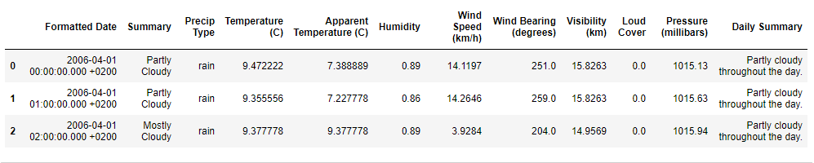
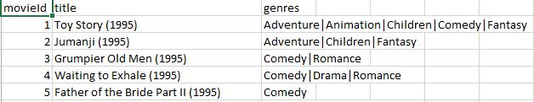
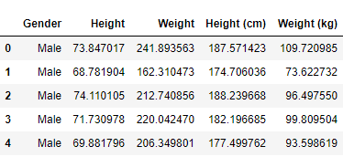
Weather History Dataset
Movielens Dataset
Height-Weight Dataset

Slide 21

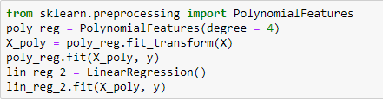
Regression
Code Snippets

Slide 22
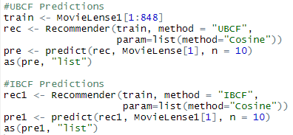
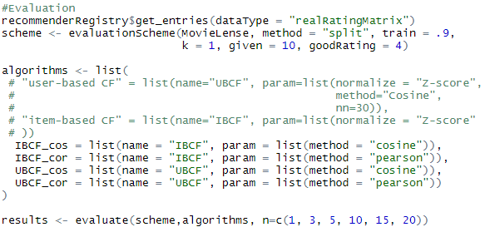
Recommender
Code Snippet

Slide 23








COMPARISONS
for linear regression and polynomial regression
PROBLEM | POLYNOMIAL REGRESSION | LINEAR REGRESSION
Weather Prediction
Height-Weight prediction
Salaries Prediction

Slide 24
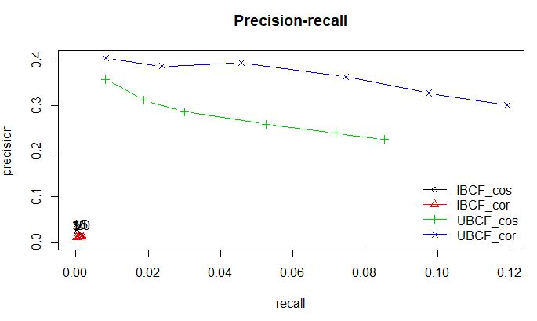
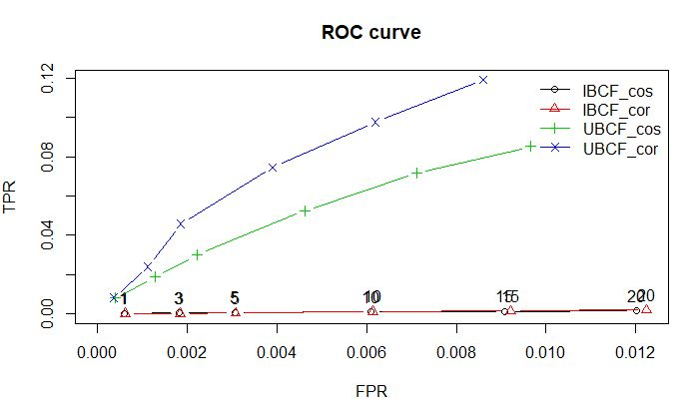
COMPARISONS
for movie recommender system

Slide 25
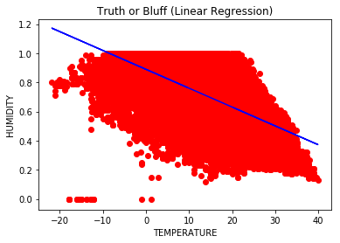
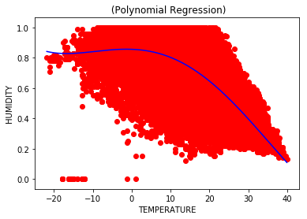
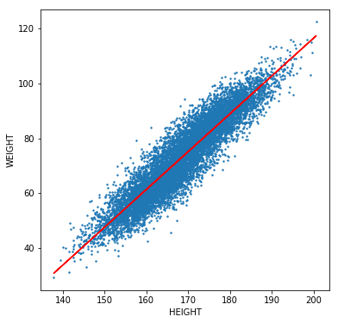
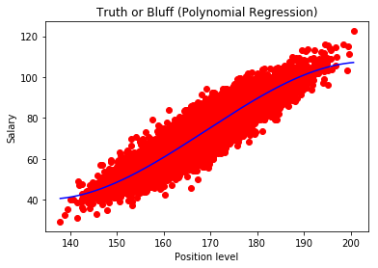
GRAPHS
Linear and Polynomial Regression
Weather Prediction
Height-Weight Prediction

Slide 26
THANK YOU

